Slide 1

Quiz Management System
Presented By:
Afrasiab Shahid (23P-0585)
M.Ahsan (23P-0543)

Slide 2
Introduction of our project
We are delighted to present our project,“Quiz Management System", developed in C language. This code provides a simple CLI-based quiz management system. It allows you to add questions, display questions, take the quiz, create users, and display user progress. The code manages questions, user information, scores, and progress tracking.Let's dive into the code to understand how it works.

Slide 3
What we used?
Header Files
string.h
stdio.h
Macros
Global Variables
Structures
Switch
Do-While Loop
If-Else Statements

Slide 4
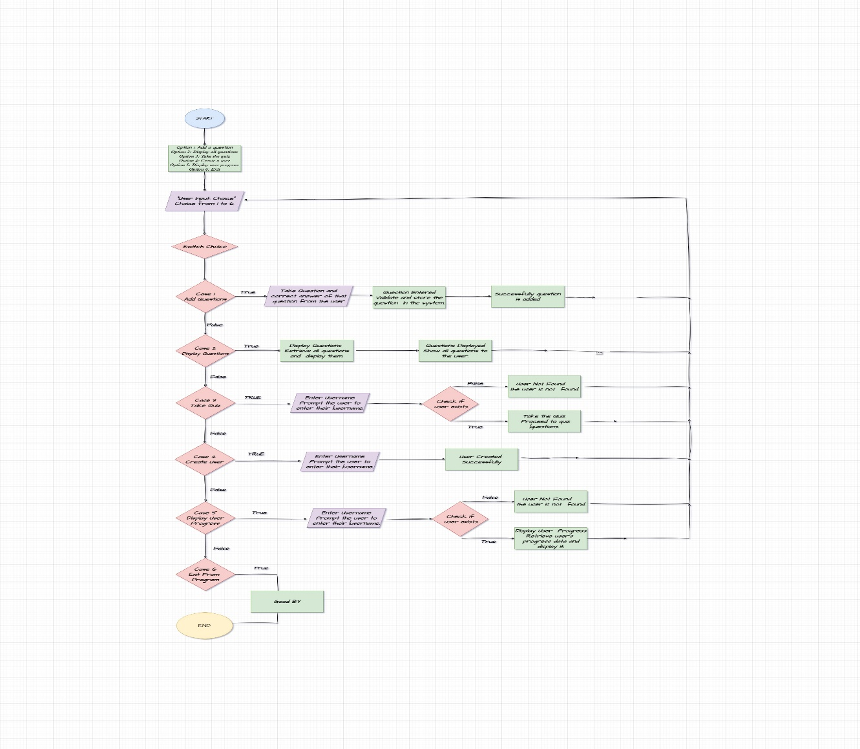
Flowchart

Slide 5
Algorithm
QUIZ MANAGING :
The provided C program is a quiz management system that allows users to interact with a set of features. It lets users add questions to a quiz, each with a text, correct answer, and point value. Users can view all the questions in the quiz and take the quiz by answering questions. The system tracks each user's score and prevents them from attempting the same question multiple times.

Slide 6
Cont.
Users can also create accounts with unique usernames, and the system displays each user's progress, including their score and which questions they have answered. The program is designed with a user-friendly menu that guides users through these functionalities. It incorporates features like constants for maximum values, structures to organize data, and functions to perform specific tasks. Overall, it provides a simple yet functional environment for managing quizzes and user interactions

Slide 7
Conclusion
Thank You!

